Slide 1
EECS 110:
Introduction to Header Files
Chris Riesbeck

Slide 2
Managing Big Programs
Big programs, like your game project, should be split into smaller files, for maintainability and faster compiling
Each file should be a coherent collection of related functions, e.g., fish drawing code, game scoring code, …
main.c should define main(), which should call the functions defined in the other files.

Slide 3
Header Files
Code files other than main.c should be split into two parts:
  code.c
    all actual function definitions
    all function prototypes that are "private," i.e., not used by any other file
  code.h
    all typedef's, enum's and struct's
    function prototypes for all functions in code.c used by other files, e.g., main.c

Slide 4
Header File Structure
#ifndef CODE_NAME
#define CODE_NAME
…structs, enums, prototypes…
#endif
The #ifndef/#define/#endif instructions are a standard idiom that makes sure that this file is loaded at most once, no matter how many files #include it.

Slide 5
Example Header File
#ifndef FISH_H
#define FISH_H
typedef struct {
int type, dir;
double x_pos, y_pos, size, speed;
unsigned long color;
} OBJECT;
void DrawFish(OBJECT *pFish);
void DrawFood(OBJECT *pFood);
void MoveFish(OBJECT *pFish);
void MoveFood(OBJECT *pFood);
#endif

Slide 6
Using Your Header Files
Use #include "…" to include any header files you defined
  Example: #include "fog.h"
Put your header files in the same folder as your C files
Use #include <…> to include standard C library header files
  Example: #include <stdlib.h>

Slide 7
Project Structure
Make sure all your .h and .c source files are in the same folder.
Make sure every file that uses functions from another file has an #include "….h" for that file.
Make sure that all .c files are actually in your Dev-C++ project.

Slide 8
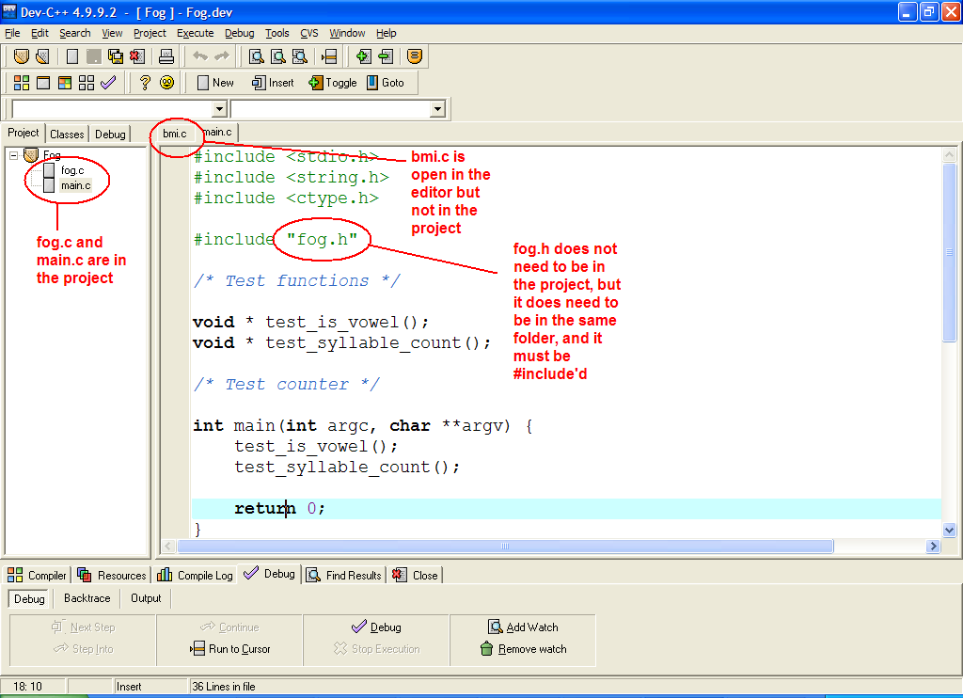
Example Project

